Slide 1
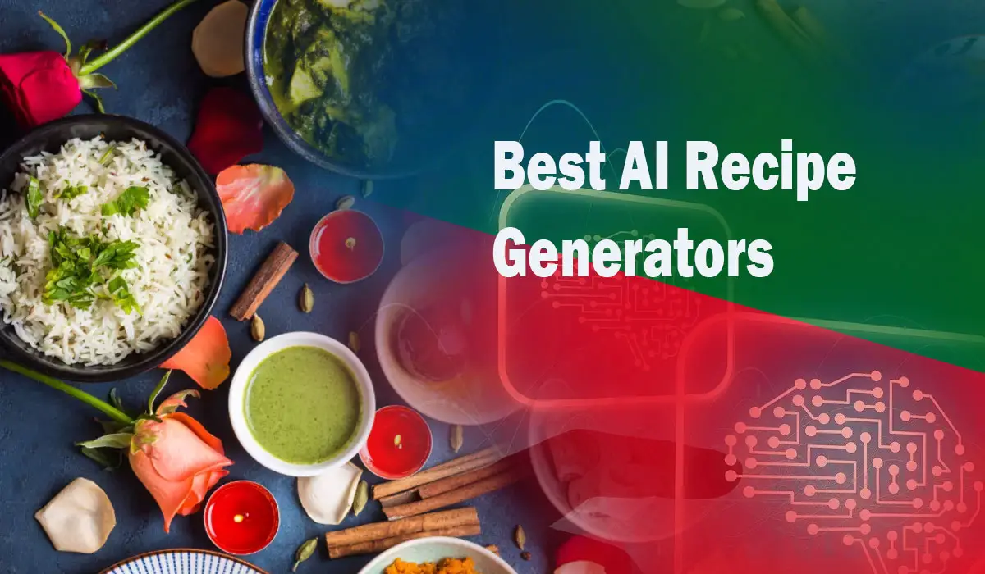

Slide 2
Introduction
Cooking can be stressful when you don’t know what to make.
Many users struggle to create recipes using the ingredients they already have.
Our goal is to Build an AI-powered tool that generates recipes from natural language input.
Makes cooking easier, faster, and more personalized using NLP.

Slide 3
Solution Overview
AI Recipe Generator built using Python and NLP techniques.
Converts user’s natural language input into complete recipes.
Useful for home cooks, diet planners, and fitness apps.

Slide 4
Workflow
User Input: Ingredients or meal preference in plain text.
NLP Processing:
Tokenization, POS tagging, and NER with spaCy.
Filter and map extracted ingredients.
Recipe Generation:
Match to a predefined recipe template.
Display recipe with ingredients & steps.

Slide 5
GitHub Link Here:
https://github.com/ashishkumar43/AI-Recipe-Generator

Slide 6
Future Scope
Integrate with Rasa for chatbot-based interaction.
Add vision model to extract ingredients from food images.
Improve recipe accuracy using ML-based recommendation.

Slide 7


